Slide 1
情報工学特別講義（第８回目）
２００９年６月３日
担当 石原
ＨＣＩ研究分野の紹介

Slide 2


Human Computer Interaction
ヒューマンコンピュータインタラクション
HCI - Human Computer Interaction
人と計算機の間でやり取りが行われるシステムの設計、
実現、評価および、それらに付随する多くの現象に関する学問
Human Modeling
Innovative I/O Devices
User Interface Design
Interaction

Slide 3
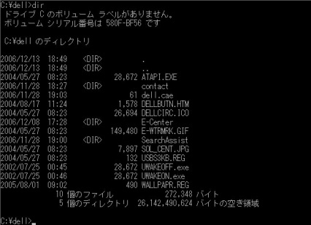
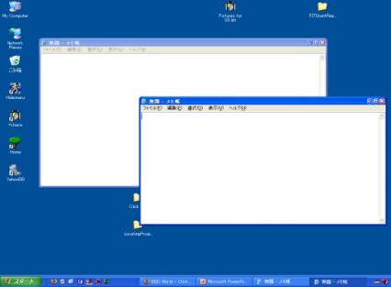
Innovative I/O Devices
人に分かりやすい装置
CUI - Character User Interface
GUI - Graphical User Interface
・MS DOS
・Linux
WIMP interaction
=Window Icon Menu Pointer
・MS Windows Vista
・Max OS
・X Window

Slide 4
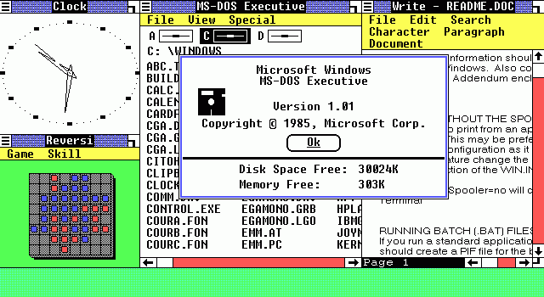
Innovative I/O Devices
人に分かりやすい装置
・MS Windows 1.01
http://www.saunalahti.fi/janij/blog/images/2008_nov_windows_1_0.png

Slide 5
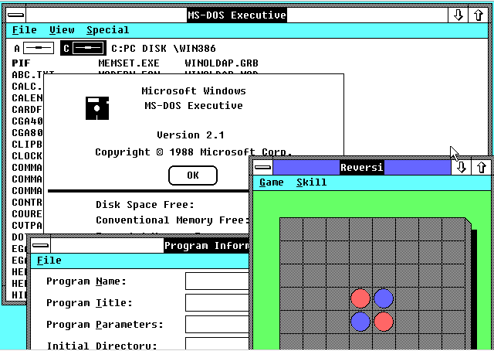
Innovative I/O Devices
人に分かりやすい装置
・MS Windows 2.1
http://osxbook.com/book/bonus/ancient/vpc/images/win21.gif

Slide 6
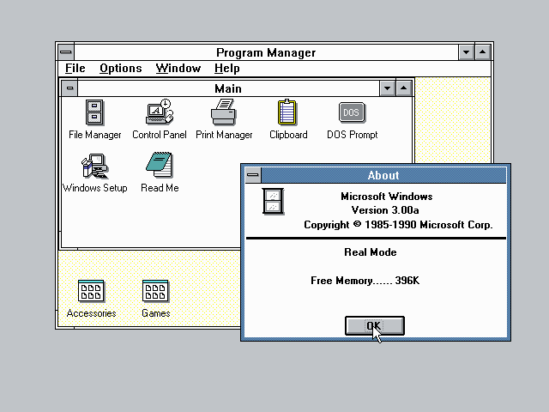
Innovative I/O Devices
人に分かりやすい装置
・MS Windows 3.0
http://catb.org/~esr/writings/taouu/html/graphics/win30progman.png

Slide 7
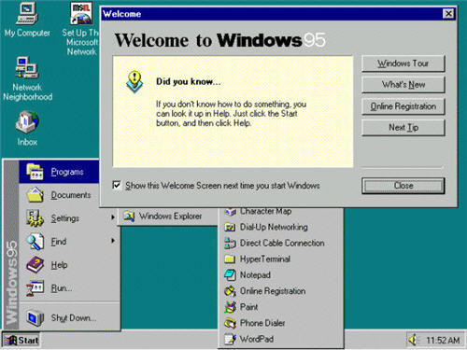
Innovative I/O Devices
人に分かりやすい装置
・MS Windows 95
http://cybernetnews.com/wp-content/uploads/2006/10/Windows95.jpg

Slide 8
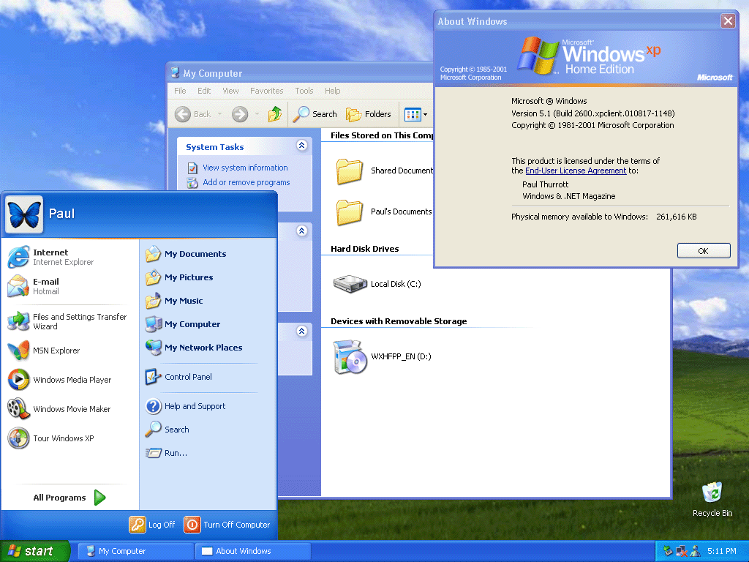
Innovative I/O Devices
人に分かりやすい装置
・MS Windows XP
http://www.winsupersite.com/images/reviews/wxp_rtm_home_004.gif

Slide 9
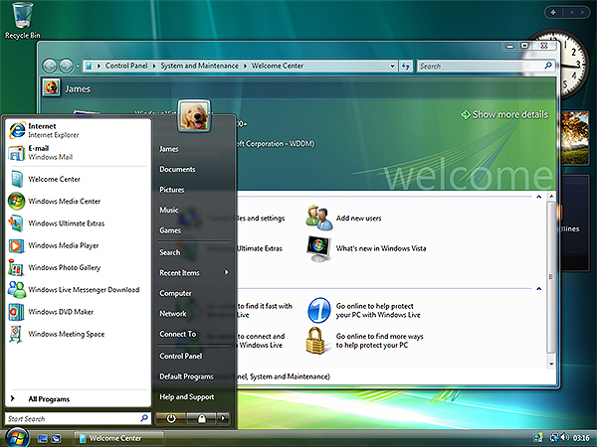
Innovative I/O Devices
人に分かりやすい装置
・MS Windows Vista
http://www.otterbein.edu/ITS/images/vista-screen.jpg

Slide 10
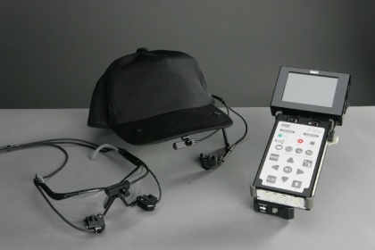
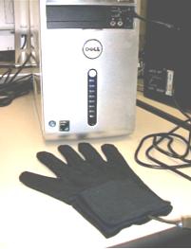
Innovative I/O Devices
人に分かりやすい装置
PUI - Perceptual User Interface
Voice
Sign
language
Eye
tracking
・MS Speech
・DGTech VHand
(Data Glove)
・NAC EMR9
Hands are the new remote control
http://news.bbc.co.uk/1/hi/programmes/click_online/7820866.stm

Slide 11
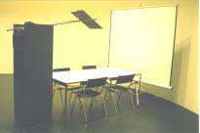
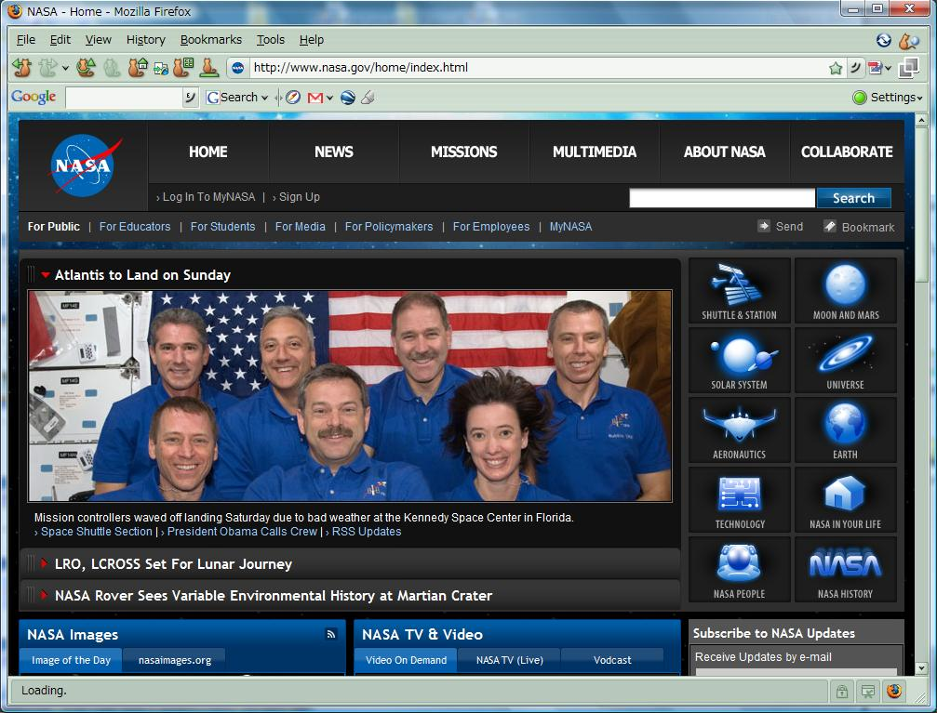
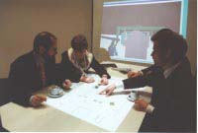
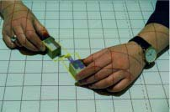
Innovative I/O Devices
人に分かりやすい装置
TUI - Tangible User Interface
WUI – Web User Interface
・BUILD-IT, Morten Fjeld et al.
・IE, Firefox etc.

Slide 12
Innovative I/O Devices
人に分かりやすい装置
BMI - Brain Machine Interface
Brain waves
Monkey's brain controls arm
http://news.bbc.co.uk/2/hi/science/nature/7426822.stm
Brain controls video game
http://www.bbc.co.uk/mediaselector/check/player/nol/newsid_6640000/newsid_6645400?redirect=6645429.stm&news=1&nbram=1&nbwm=1&bbwm=1&bbram=1

Slide 13
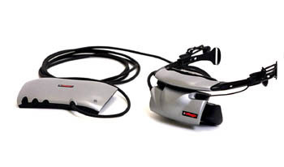
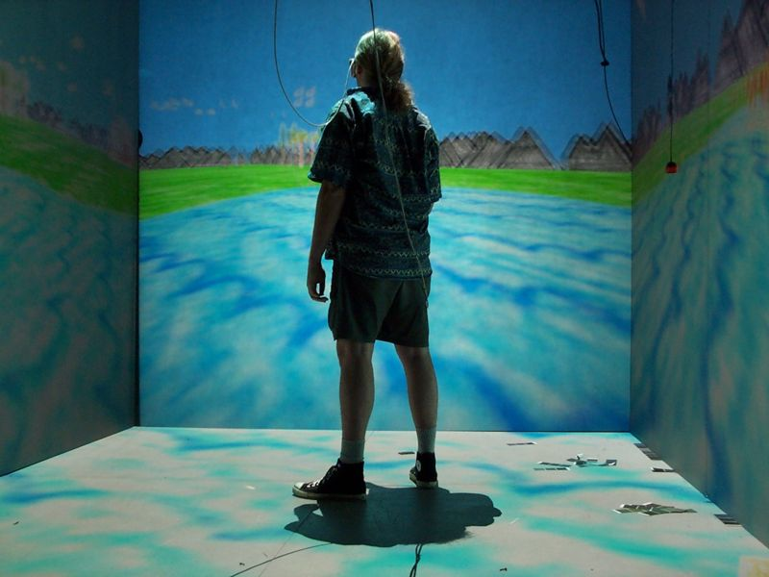
Innovative I/O Devices
人に分かりやすい装置
Immersive Environment
・CAVE System
・eMagin Z800 3DVisor
(Head-mounted display)
Remote Impact game in action
http://news.bbc.co.uk/go/em/fr/-/2/hi/uk_news/scotland/7423404.stm
Wikipedia
http://en.wikipedia.org/wiki/Cave_Automatic_Virtual_Environment

Slide 14
Innovative I/O Devices
人に分かりやすい装置
Current trends
MR - Mixed Reality
・mixture between reality and virtuality
Universal Access
・kids
・young people
・elderly people
・people with special needs

Slide 15
User Interface Design
人にやさしいﾕｰｻﾞｲﾝﾀﾌｪｰｽ
Information Space
In the past,
IS
1D Data
Ex. Characters
CUI
Interaction
a keyboard and
a screen
IS
Nowadays,
PUI, TUI,
BMI, CAVE,
HMD etc.
?
?
?
GUI
(WIMP)
Interaction
+ a mouse
2D~ Data
Ex. Images, music, movies etc.
Got Lost !
Get-Lost Problem
迷子問題

Slide 16
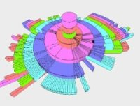
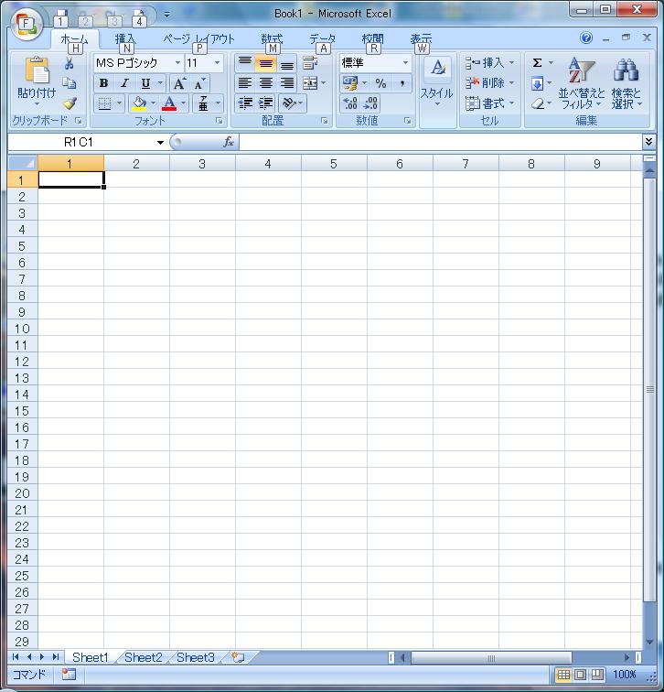
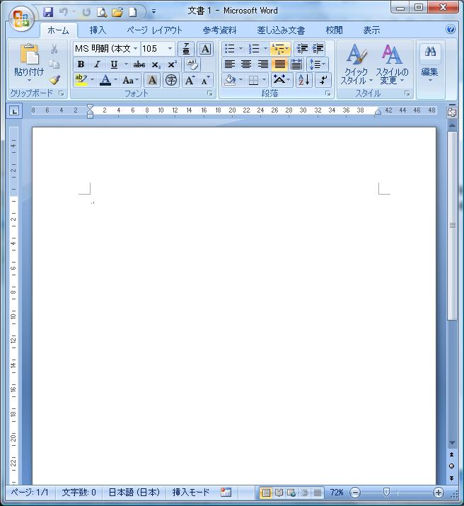
User Interface Design
人にやさしいﾕｰｻﾞｲﾝﾀﾌｪｰｽ
Current trends
User (Experience)-centered design
・Intuitive to use. Ex. a door, light switch, glasses, mouse
・Use of Metaphor. Ex. desktop metaphor
M. Ueno, FIT, 2007
!=Task-centered design
Spreadsheet
Word processor
!=Equipment-centered design
・Uses the advantage of equipment.
Ex. CAVE → Immersive env. → Viewing 3D volumetric data
Ex. HMD → Stereo → Working in a 3D env.
CAVE
HMD

Slide 17
User Interface Design
人にやさしいﾕｰｻﾞｲﾝﾀﾌｪｰｽ
Current trends
User friendly design (~ Universal Access)
・Easy to use
Ex. systems designed for kids, young people and elderly people
A touch panel
・Where you touch is where you point
・Direct manipulation
Augmented cognition
・Adapts the user interface to the state of people
>java
>java

Slide 18
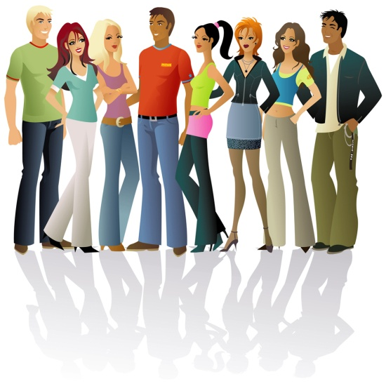

Human Modeling
人とは何か？
Human factor
・understands people’s ability
People → Finite capacity of short-term memory
Children → Short attention spans
Novices → Lack on knowledge
People with special needs → Point of view of what works

Slide 19
Human Modeling
人とは何か？
Current trends
Cognitive Psychology
・studies how people mentally represent information
Ex. graph and set representation etc.
Ex. flow chart, Gantt chart, arrow diagram etc.

Slide 20
Human Modeling
人とは何か？
Current trends
Cognitive Ergonomics
・analyses the process of thinking, understanding
・helps people perform cognitive tasks
(describing making-decision)
Ex.
Clarify problem
Consider options
Positives
Negatives
Which outweighs which?
Make decision

Slide 21
Research work
研究活動
Experience-centered design

Slide 22
Research Work
研究活動
User friendly design
Direct manipulation

Slide 23
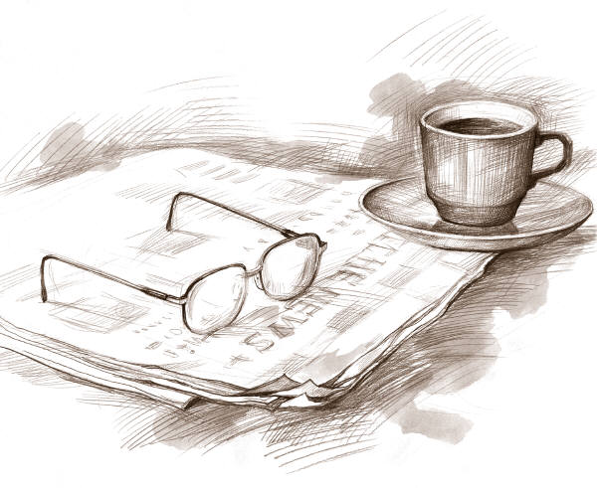
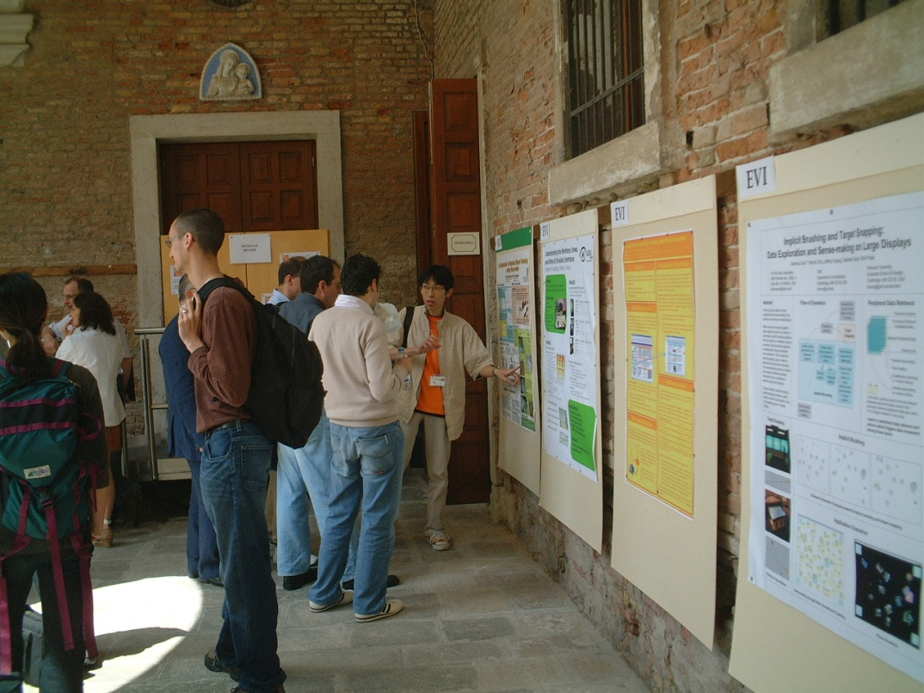
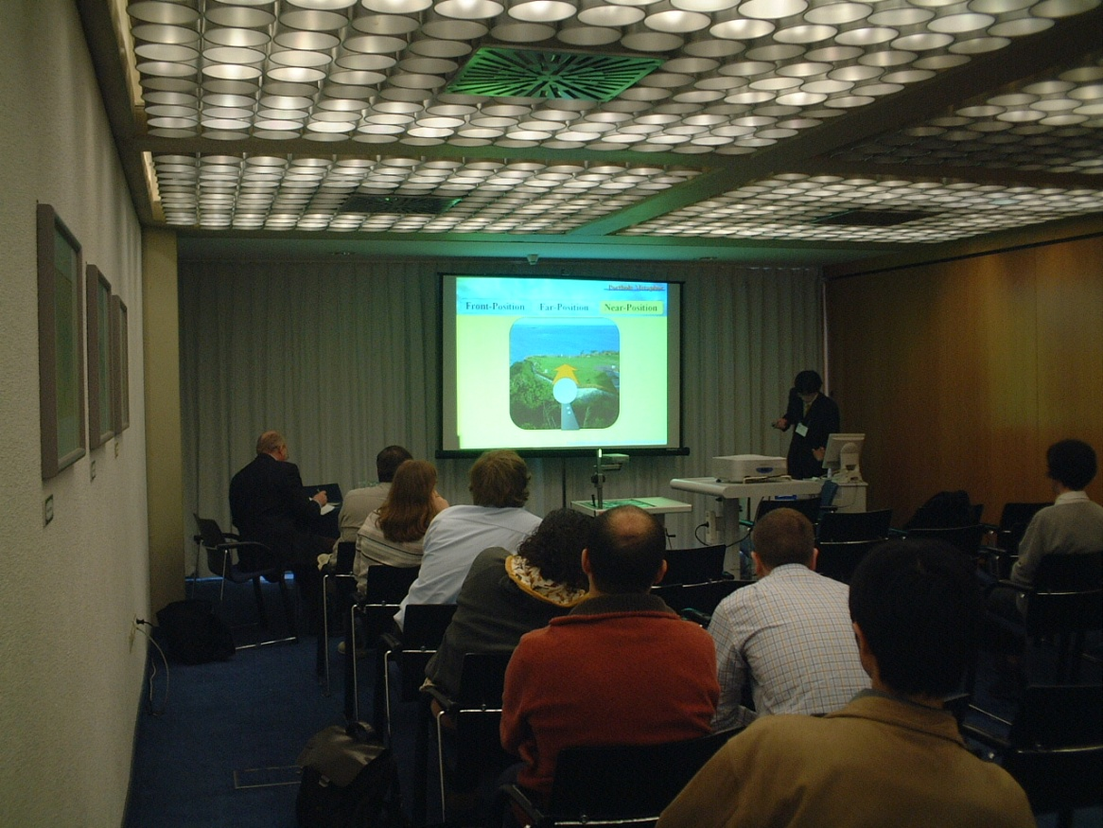
International Conf.
国際会議
Oral session
Poster session

Slide 24
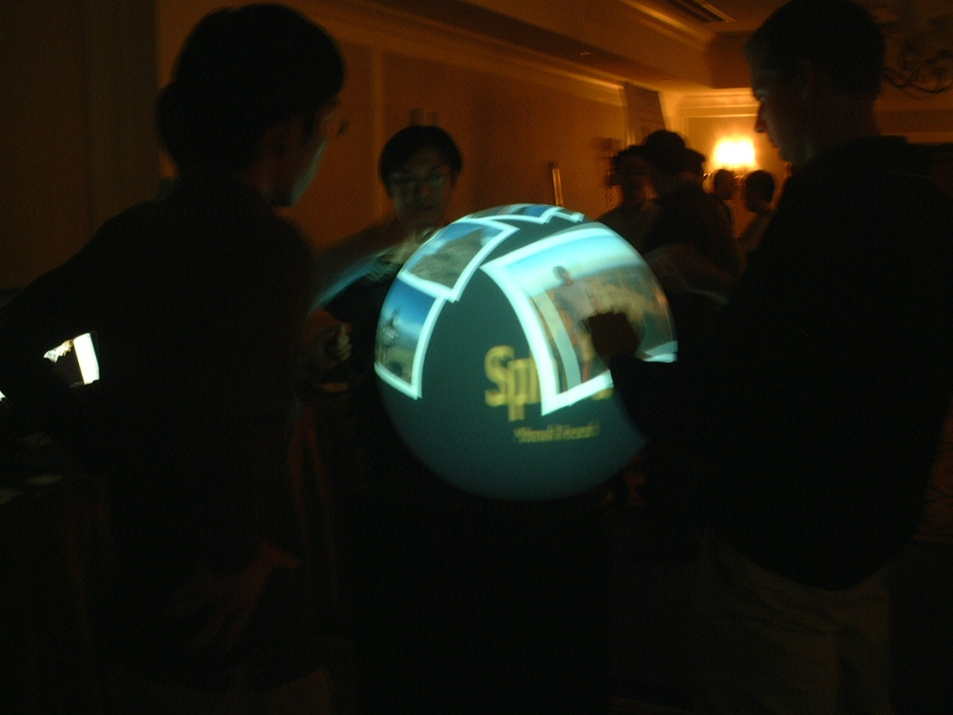
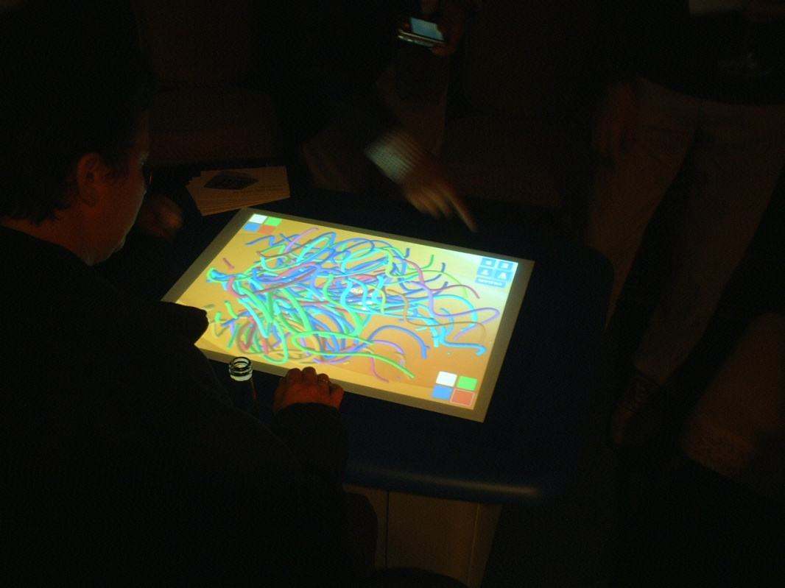
International Conf.
国際会議
SMART Table
SMART Technologies
UIST2008, Monterey, CA, USA
Demo
Exhibition
Spherical Display
Microsoft Research
UIST2008, Monterey, CA, USA

Slide 25
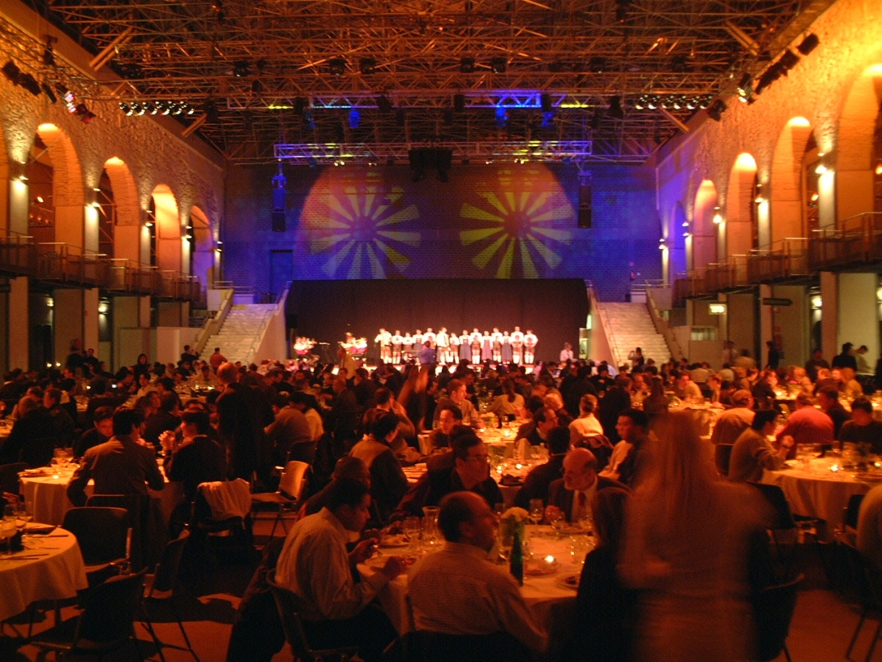
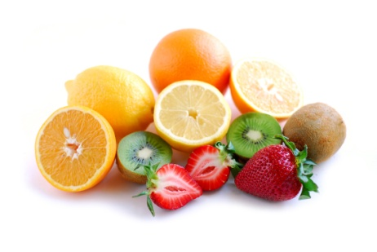
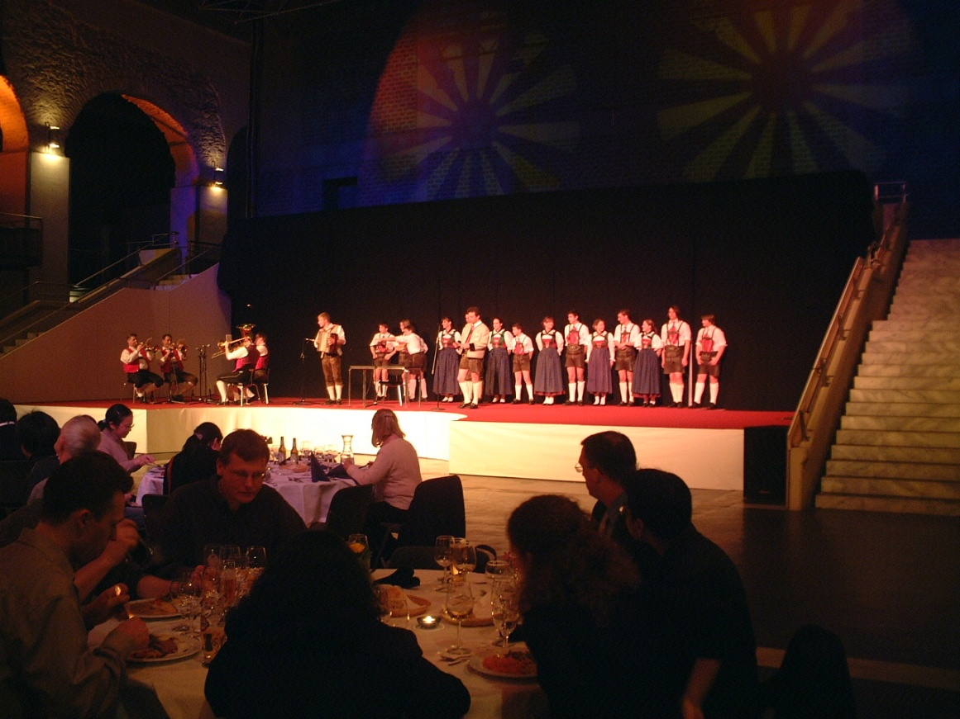
International Conf.
国際会議
Ethnic dance and music
Banquets
Ethnic dance
Banquets, IASTED, Innsbruck, Austria

Slide 26
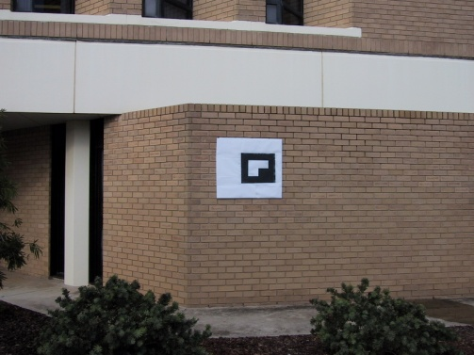
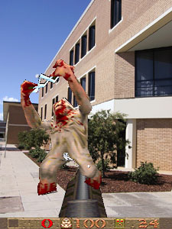
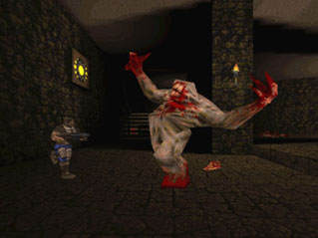

Mixed Reality
混合現実感
Buildings
Mixed reality
Physical reality
Augmented reality
Augmented virtuality
Virtual reality
Quake I
Photos from ARQuake project, Wearable Computer Lab, University of South Australia

Slide 27


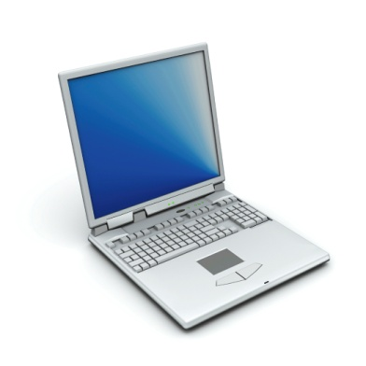

Mixed Reality
混合現実
AR Toolkit
・Software library to build a AR environment.
・Freeware
・C, OpenGL
overlay
G
Demo

