Slide 1
Fingertip-shadow for
click, db-click, and drag on a wall

Slide 2
Background
- Touch Panel -
The position you have touched is detected
by the sensor embedded in the surface.

Slide 3
Background
If sensors cannot be embedded in the surface, what alternative way is available ?
- Projector -
- Screen -

Slide 4
Background
Use two cameras Use one camera
- Cam 1 -
- Cam -
Touched!!
Touched!!
- Cam 2 -
Touching is detected
instantly
Touching is not detected
instantly

Slide 5
Aim of this study
We use ONE camera to determine instantly
if a fingertip has touched a screen.
- Cam -
Touched!!
- Projector -
- Screen -

Slide 6
Fingertip shadow in touching a screen
When a fingertip is
not on the screen,
When a fingertip is
on the screen,

Slide 7
Fingertip shadow in touching a screen
- Screen -
Fingertip is NOT on the screen
- Screen -
Fingertip is on the screen

Slide 8
Fingertip shadow in touching a screen
When do clickin, clickout, and move occur ?
clickin
clickout
move

Slide 9
Fingertip shadow in touching a screen
click, db-click, and drag are formed
by clickin, clickout, and move.
click
db-click
clickin+clickout
clickin+clickout
+clickin+clickout
click
db-click
drag
drag
clickin+move

Slide 10
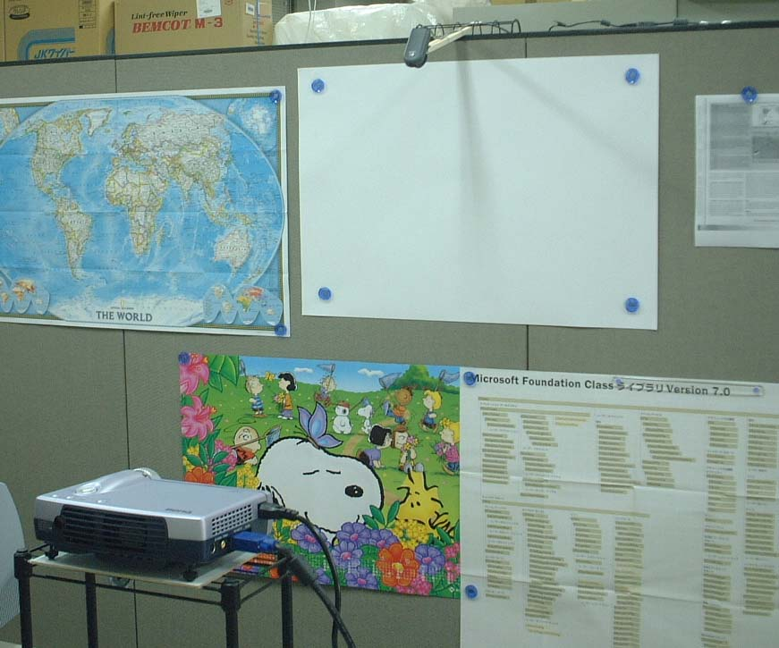
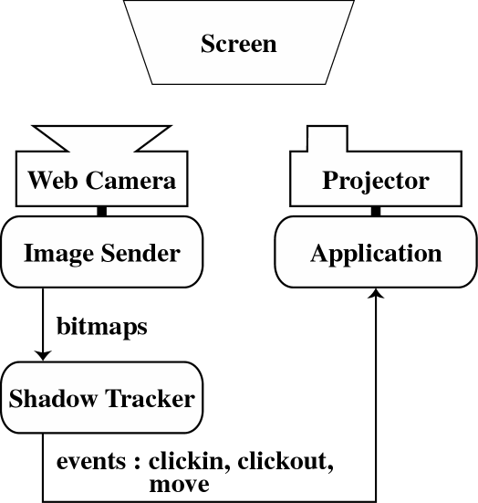
Application
Look of our system Framework of our system
Camera
Screen
Projector

Slide 11
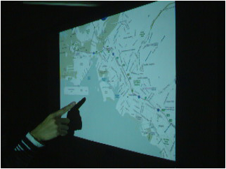
Application
Map View
A user is allowed to manipulate a map by touching.
Zooming in, scrolling,
and zooming out a map

Slide 12
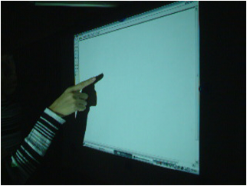
Application
MS Paint
Writing “Hello!”

Slide 13
Conclusions
Fingertip-shadow for
click, db-click, and drag on a wall
We focused on fingertip shadow in order to
determine if the fingertip has touched a screen.
We built a system providing click, db-click,
and drag.
We applied the system to two applications.

