Slide 1
情報工学特別講義（第１０回目）
２０１０年６月１６日
担当 石原
ＨＣＩ研究分野の紹介

Slide 2

Question: What is HCI ?
1. How Can I?
→Chat
2. Help Crime Increase
→Law
3. Host Controller Interface
→Network
4. Human Computer Interaction
→Software
5. Hya~ Cho~ hosiii~ I-Pad!!
→?????

Slide 3
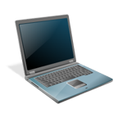

Human Computer Interaction
ヒューマンコンピュータインタラクション
HCI - Human Computer Interaction
人と計算機の間でやり取りが行われるシステムの設計、
実現、評価および、それらに付随する多くの現象に関する学問
Human Modeling
User Interface & Devices
User Interaction Design
Interaction

Slide 4
User Interface & Devices
分かりやすいユーザインタフェース
Human Modeling
User Interface & Devices
User Interaction Design
Interaction

Slide 5
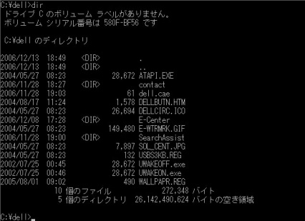
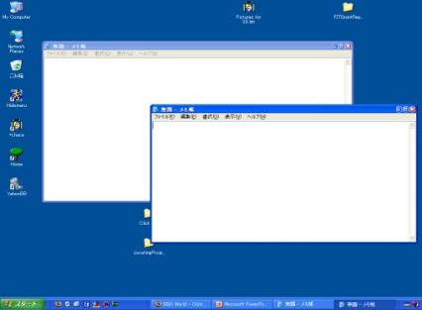
User Interface & Devices
分かりやすいユーザインタフェース
CUI - Character User Interface
GUI - Graphical User Interface
・MS DOS
・Linux
WIMP interaction
=Window Icon Menu Pointer
・MS Windows
・Max OS
・X Window

Slide 6
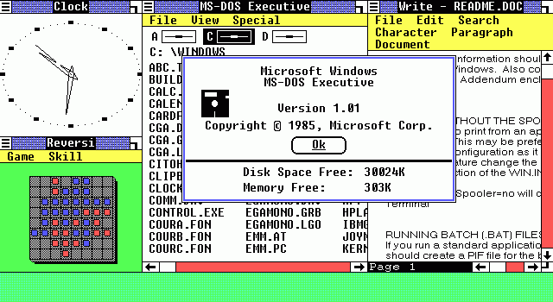
User Interface & Devices
GUI, Multi-tasking
分かりやすいユーザインタフェース
・MS Windows 1.01 (1985~)
http://www.saunalahti.fi/janij/blog/images/2008_nov_windows_1_0.png

Slide 7
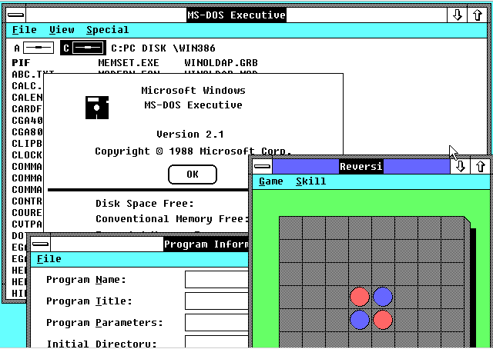
User Interface & Devices
Overlaps of windows, Mini-Maximum buttons
分かりやすいユーザインタフェース
・MS Windows 2.1 (1988~)
http://osxbook.com/book/bonus/ancient/vpc/images/win21.gif

Slide 8
User Interface & Devices
分かりやすいユーザインタフェース
Question: Which looks Pressed ?
1.
OK
2.
OK

Slide 9
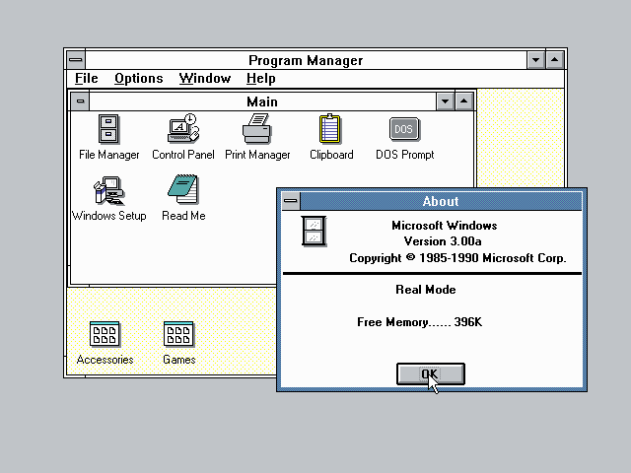
User Interface & Devices
16 colors, Multimedia support (CD-ROM, sound)
分かりやすいユーザインタフェース
・MS Windows 3.0 (1990~)
http://catb.org/~esr/writings/taouu/html/graphics/win30progman.png

Slide 10
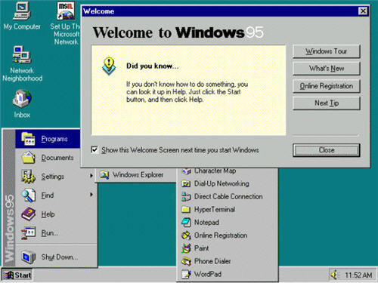
User Interface & Devices
Start menu, Task bar, Desktop folder
分かりやすいユーザインタフェース
・MS Windows 95 (1995~)
http://cybernetnews.com/wp-content/uploads/2006/10/Windows95.jpg

Slide 11
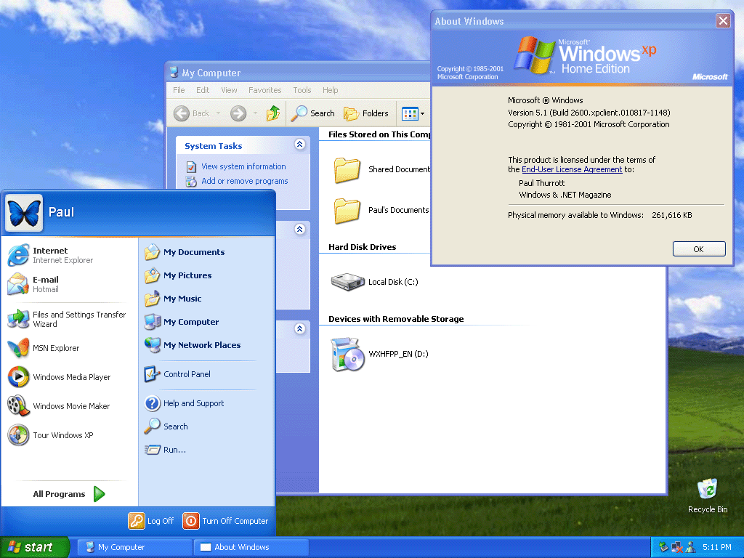
User Interface & Devices
True-color, Drop shadows, Soften appearance
分かりやすいユーザインタフェース
・MS Windows XP (2001~)
http://www.winsupersite.com/images/reviews/wxp_rtm_home_004.gif

Slide 12
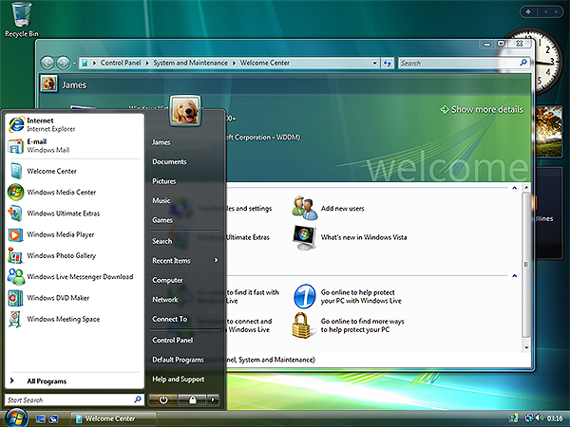
User Interface & Devices
Aero interface, Side bar &Gadgets
分かりやすいユーザインタフェース
・MS Windows Vista (2007~)
http://www.otterbein.edu/ITS/images/vista-screen.jpg

Slide 13
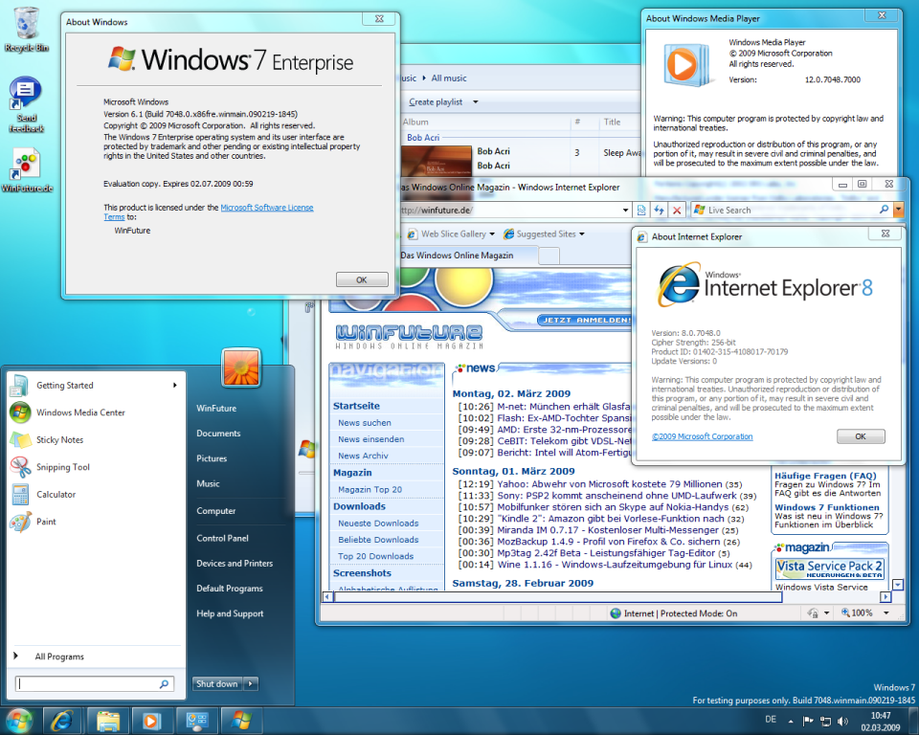
User Interface & Devices
Peek, Shake, Snap, Windows Touch
分かりやすいユーザインタフェース
・MS Windows 7 (2009~)
http://screenshots.winfuture.de/Windows-7-Build-6.1.7048-1235994358.jpg

Slide 14
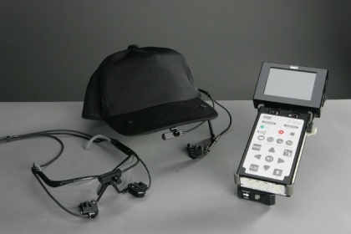
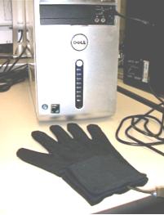
User Interface & Devices
分かりやすいユーザインタフェース
PUI - Perceptual User Interface
Voice
Sign
language
Eye
tracking
・MS Speech
・DGTech VHand
(Data Glove)
・NAC EMR9
Hands are the new remote control
http://news.bbc.co.uk/1/hi/programmes/click_online/7820866.stm

Slide 15
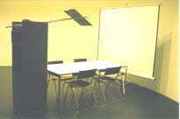
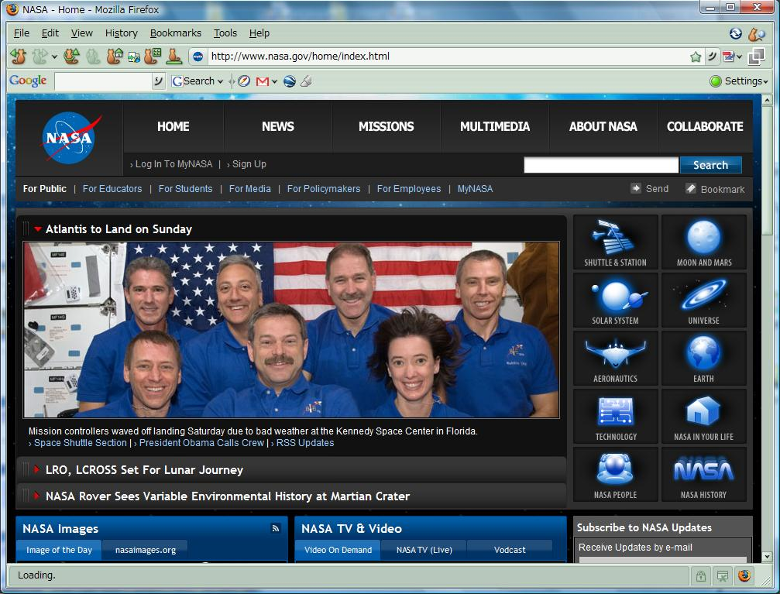
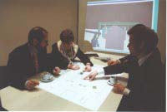
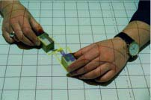
User Interface & Devices
分かりやすいユーザインタフェース
TUI - Tangible User Interface
WUI – Web User Interface
・BUILD-IT, Morten Fjeld et al.
・IE, Firefox etc.

Slide 16
User Interface & Devices
分かりやすいユーザインタフェース
BMI - Brain Machine Interface
Brain waves
Monkey's brain controls arm
http://news.bbc.co.uk/2/hi/science/nature/7426822.stm

Slide 17
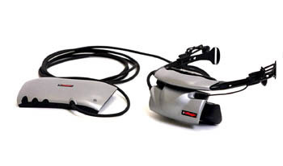
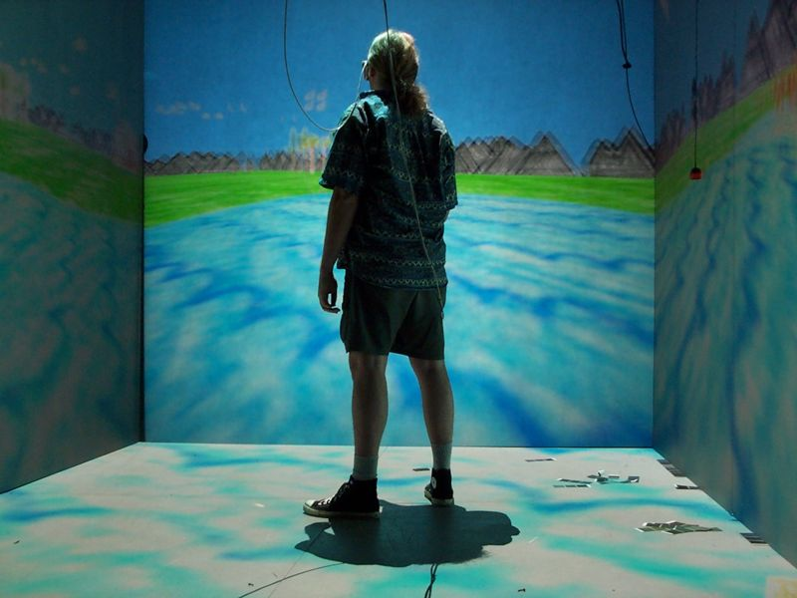
User Interface & Devices
分かりやすいユーザインタフェース
Immersive Environment
・CAVE System
・eMagin Z800 3DVisor
(Head-mounted display)
Remote Impact game in action
http://news.bbc.co.uk/go/em/fr/-/2/hi/uk_news/scotland/7423404.stm
Wikipedia
http://en.wikipedia.org/wiki/Cave_Automatic_Virtual_Environment

Slide 18
User Interface & Devices
分かりやすいユーザインタフェース
Current trends
MR - Mixed Reality
・mixture between reality and virtuality
Augmented reality apps for mobile phones
http://news.bbc.co.uk/2/hi/programmes/click_online/8424412.stm
Universal Access
・kids
・young people
・elderly people
・people with special needs

Slide 19
User Interaction Design
人にやさしいインタラクション
Human Modeling
User Interface & Devices
User Interaction Design
Interaction

Slide 20
User Interaction Design
人にやさしいインタラクション
Information Space
In the past,
IS
1D Data
Ex. Characters
CUI
Interaction
a keyboard and
screen
IS
Nowadays,
PUI, TUI,
BMI, CAVE,
HMD etc.
?
?
?
GUI
(WIMP)
Interaction
+ a mouse
2D~ Data
Ex. images, music, movies, 3D movies etc.
Got Lost !
Get-Lost Problem
迷子問題

Slide 21
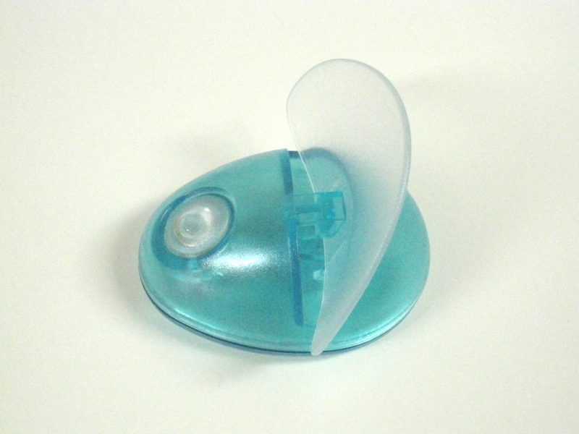
User Interaction Design
人にやさしいインタラクション
Question: Do you know how to use it ?
1.

Slide 22
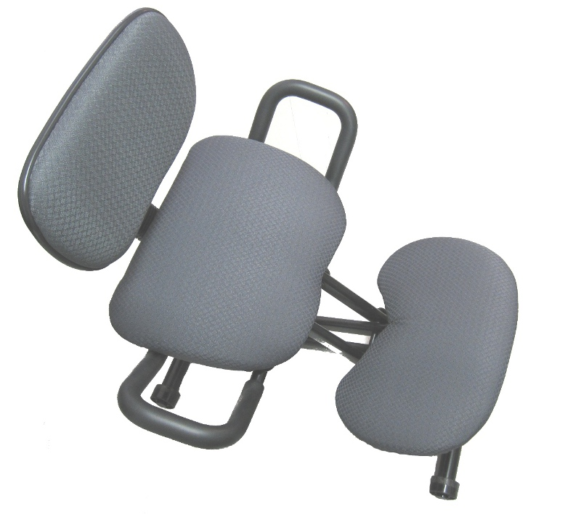
User Interaction Design
人にやさしいインタラクション
Question: Do you know how to use it ?
2.

Slide 23
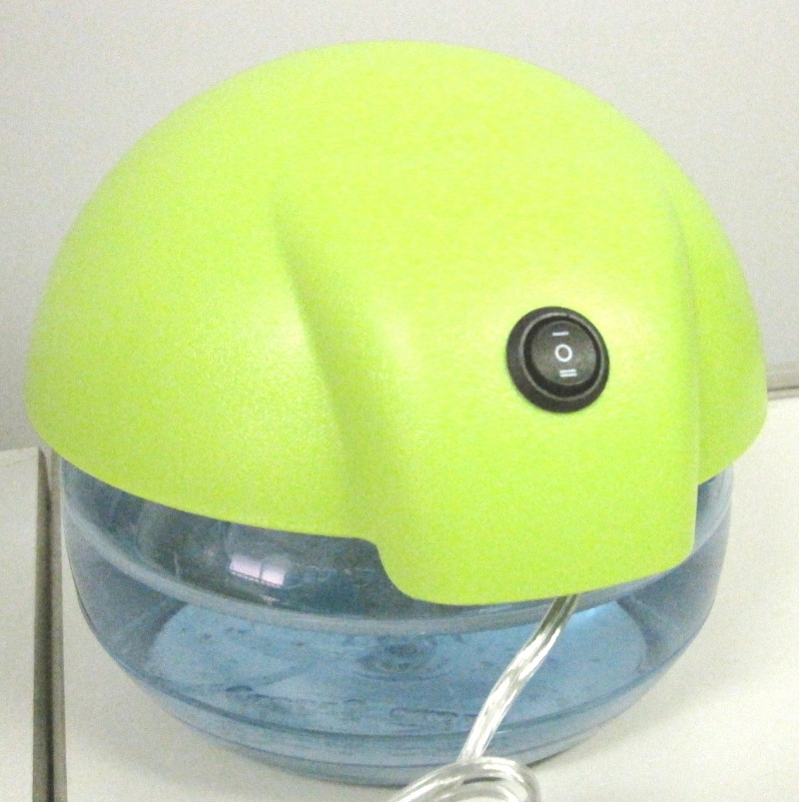
User Interaction Design
人にやさしいインタラクション
Question: Do you know how to use it ?
3.

Slide 24

User Interaction Design
人にやさしいインタラクション
Affordance – a perceptual manifestation of what users can do by using the object or technique.
対象を使って何ができるかを伝える知覚的な明示
Constraints – a perceptual manifestation of what users cannot do by using the object or technique.
対象を使って何ができないかを伝える知覚的な明示
from D. A. Bowman et al. , 3D User Interface ~theory and practice~, Addison-Wesley

Slide 25
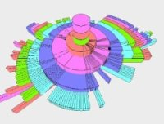
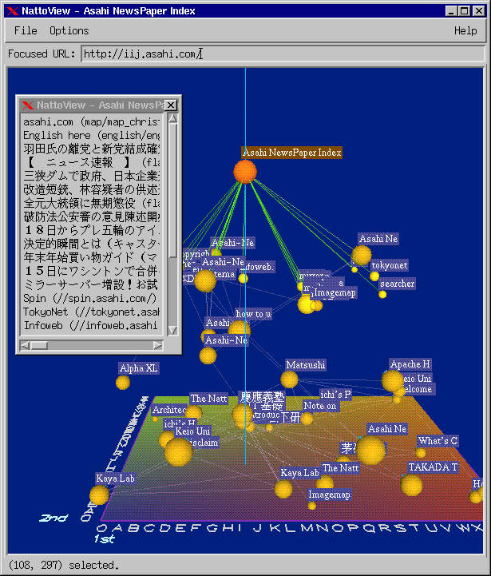

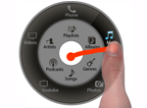
User Interaction Design
人にやさしいインタラクション
Current trends (1/4)
User (Experience)-centered design
・intuitive to use. Ex. doors, light switches, glasses, mouse
・use of metaphor. Ex. desktop metaphor
Network Nodes Viewer,
Natto Metaphor, Dr. Shiozawa et al., 1997
Hierarchical Data Viewer
Drawer Metaphor,
Mr. Ueno, FIT, 2007
Mobile Control Panel
Wavelet Metaphor, Dr. Francone et al., 2010

Slide 26
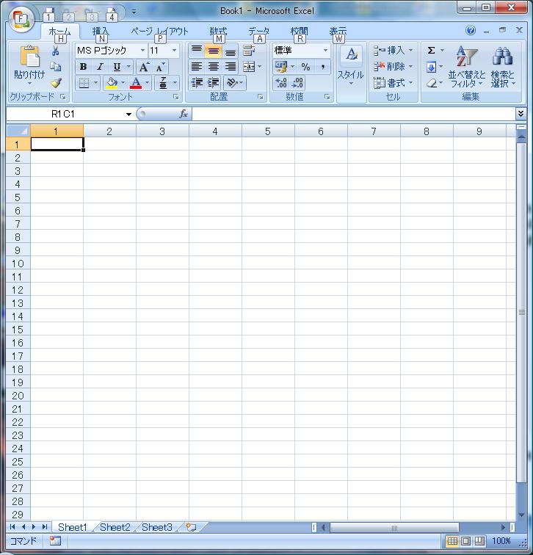
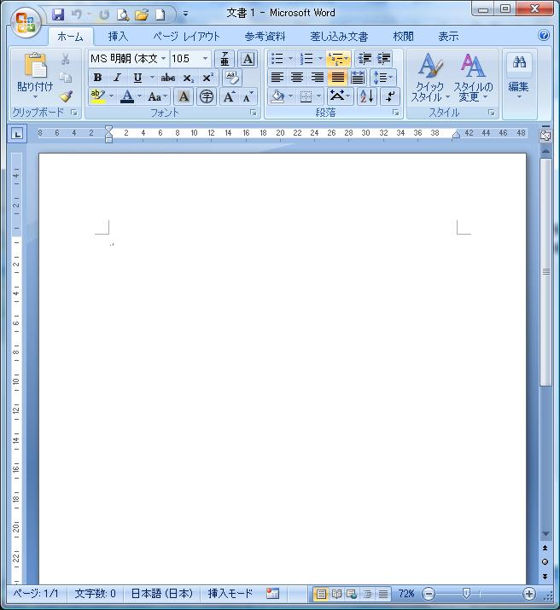
User Interaction Design
人にやさしいインタラクション
Current trends (2/4)
!=Task-centered design
Spreadsheet
Word processor
!=Equipment-centered design
・uses the advantage of equipment.
Ex. CAVE → Immersive env. → Viewing 3D volumetric data
Ex. HMD → Stereo → Working in a 3D env.
CAVE
HMD

Slide 27
User Interaction Design
人にやさしいインタラクション
Current trends (3/4)
User friendly design (~ Universal Access)
・easy to use
Ex. systems designed for kids, young people and elderly people
A touch screen system (~multi-touch)
・where you touch is where you point
・direct manipulation
Apple's iPad touchscreen computer
http://news.bbc.co.uk/2/hi/technology/8484823.stm
The good and the bad of the new iPad
http://news.bbc.co.uk/2/hi/programmes/click_online/8487728.stm

Slide 28
User Interaction Design
人にやさしいインタラクション
Question: What is your gesture ?
1.
Before
After
from Prof. D. Wigdor (Microsoft) as Invited talk, AVI2010, Roma, Italy

Slide 29
User Interaction Design
人にやさしいインタラクション
Question: What is your gesture ?
2.
Before
After
from Prof. D. Wigdor (Microsoft) as Invited talk, AVI2010, Roma, Italy

Slide 30
User Interaction Design
人にやさしいインタラクション
Question: What is your gesture ?
3.
Before
After
from Prof. D. Wigdor (Microsoft) as Invited talk, AVI2010, Roma, Italy

Slide 31
User Interaction Design
人にやさしいインタラクション
Current trends (4/4)
Augmented cognition
・adapts the user interface to the state of people
>java
>java

Slide 32
Human Modeling
人とは何か？
Human Modeling
User Interface & Devices
User Interaction Design
Interaction

Slide 33
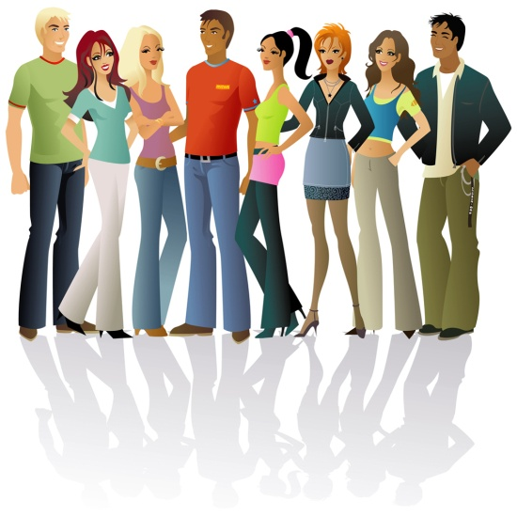

Human Modeling
人とは何か？
Human factor
・understands people’s ability
People → Finite capacity of short-term memory
Children → Short attention spans
Novices → Lack on knowledge
People with special needs → Point of view of what works

Slide 34
Human Modeling
人とは何か？
Current trends (1/2)
Cognitive Psychology
・studies how people mentally represent information
Ex. graph and set representation etc.
Ex. flow chart, Gantt chart, arrow diagram etc.

Slide 35
Human Modeling
人とは何か？
Current trends (2/2)
Cognitive Ergonomics
・analyses the process of thinking, understanding
・helps people perform cognitive tasks
(describing making-decision)
Ex.
Clarify problem
Consider options
Positives
Negatives
Which outweighs which?
Make decision

Slide 36
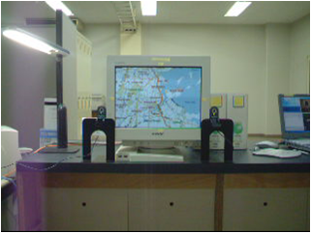
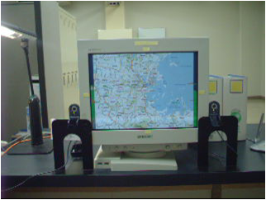
My Research Work
私の研究活動
Experience-centered design
Window Metaphor ~ Zoom
Window Metaphor ~ Scroll
M. Ishihara et al, “Porthole: A spatial interface to provide scrolling, zooming-in, and zooming-out”, 2005

Slide 37
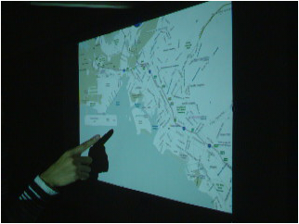
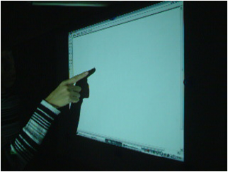
My Research Work
私の研究活動
User friendly design & Direct manipulation
MS Paint on Projection
Map Viewer on Projection
M. Ishihara et al, “Fingertip-shadow for click, db-click, and drag on a wall”, 2005

Slide 38
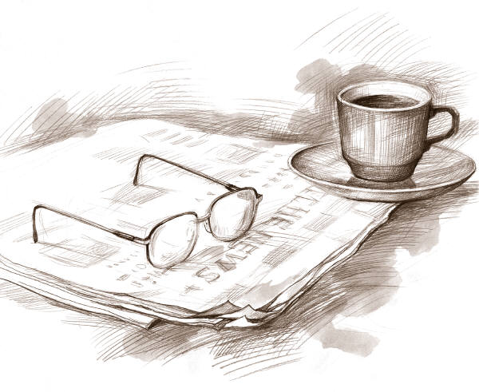
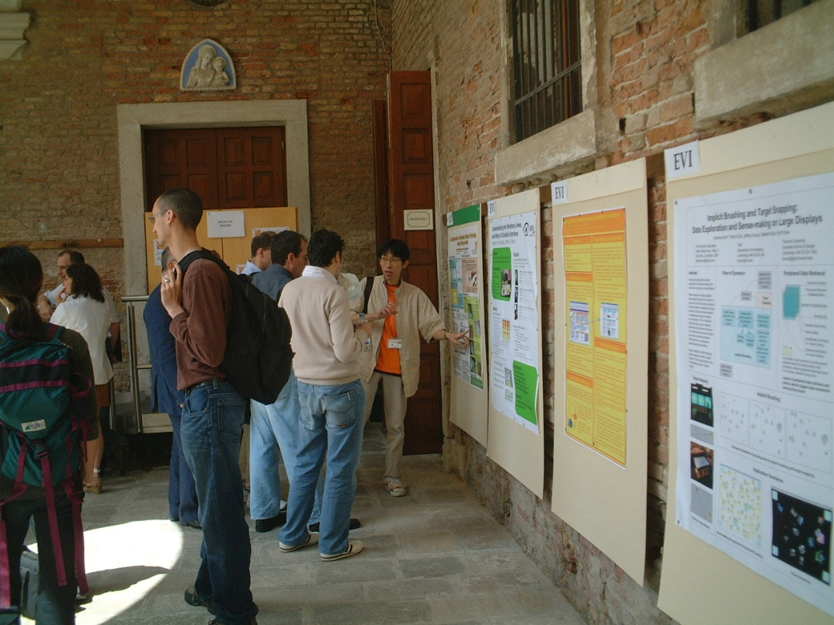
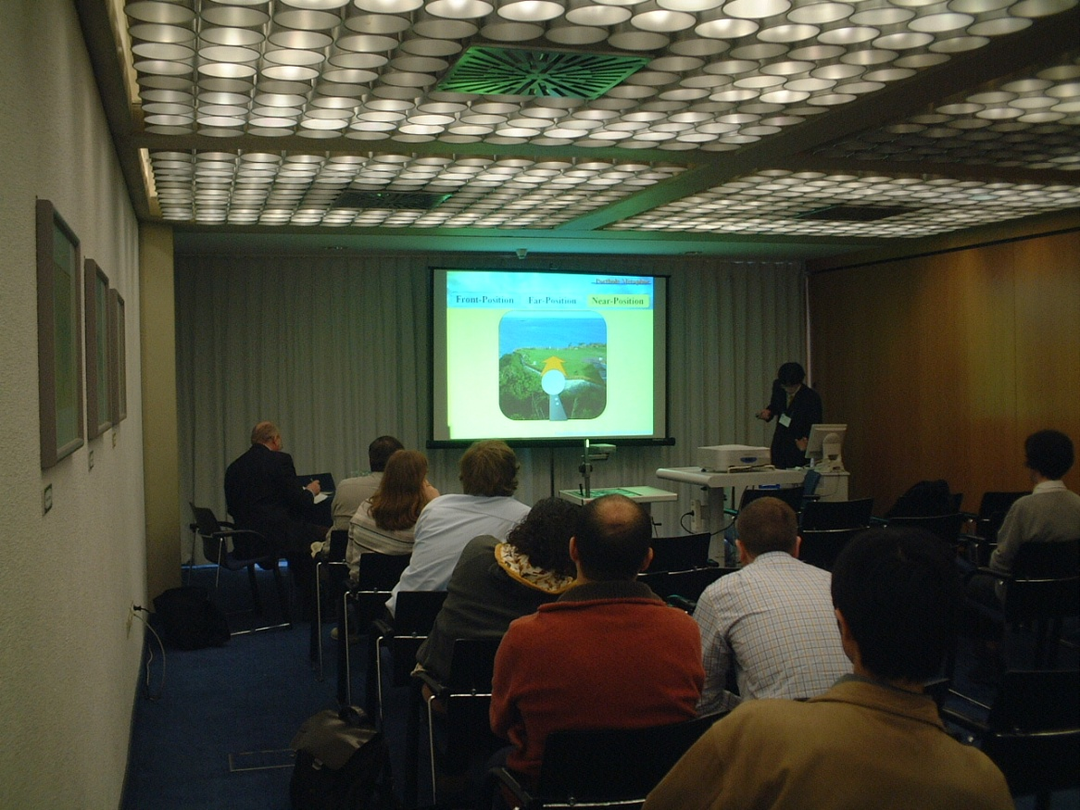
International Conf.
国際会議
Oral session
Poster session

Slide 39
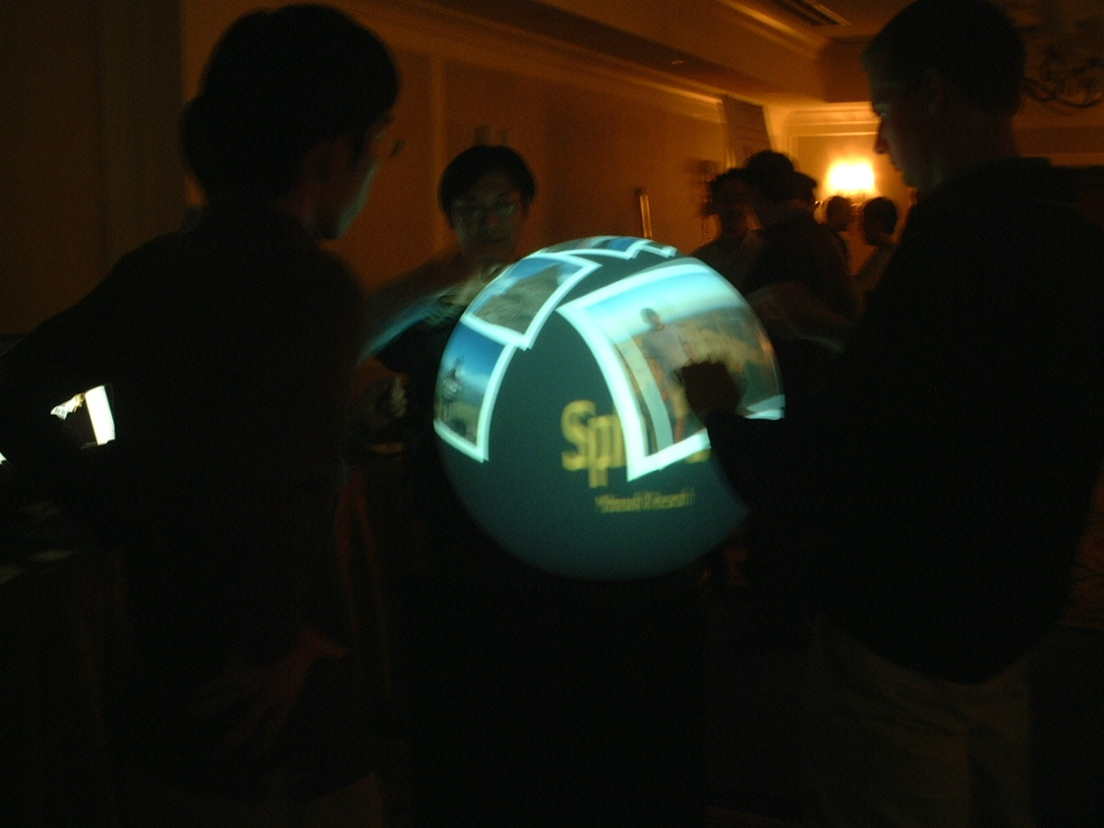
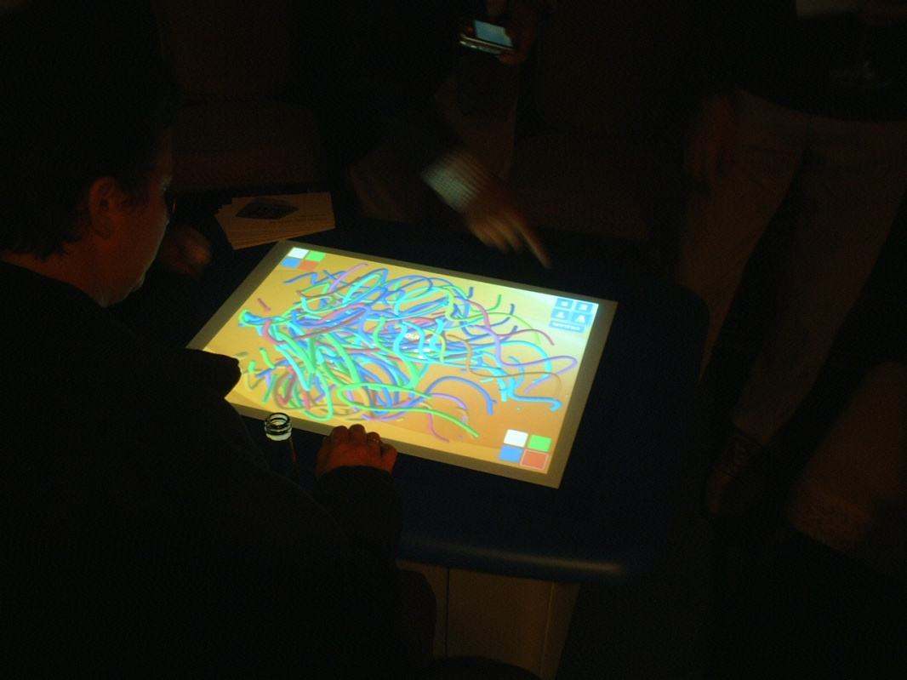
International Conf.
国際会議
SMART Table
SMART Technologies
UIST2008, Monterey, CA, USA
Demo
Exhibition
Spherical Display
Microsoft Research
UIST2008, Monterey, CA, USA

Slide 40
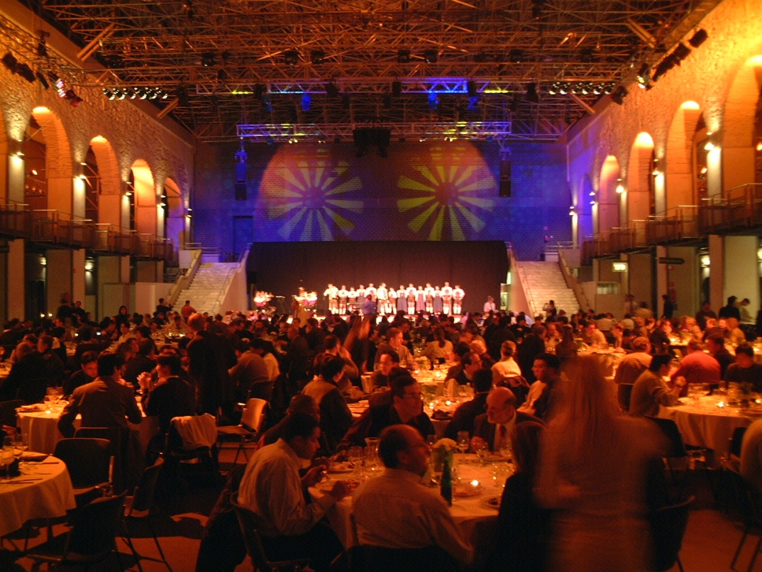
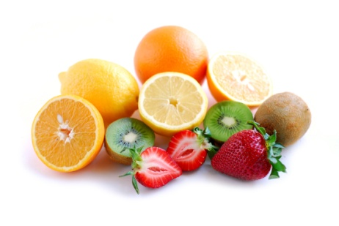
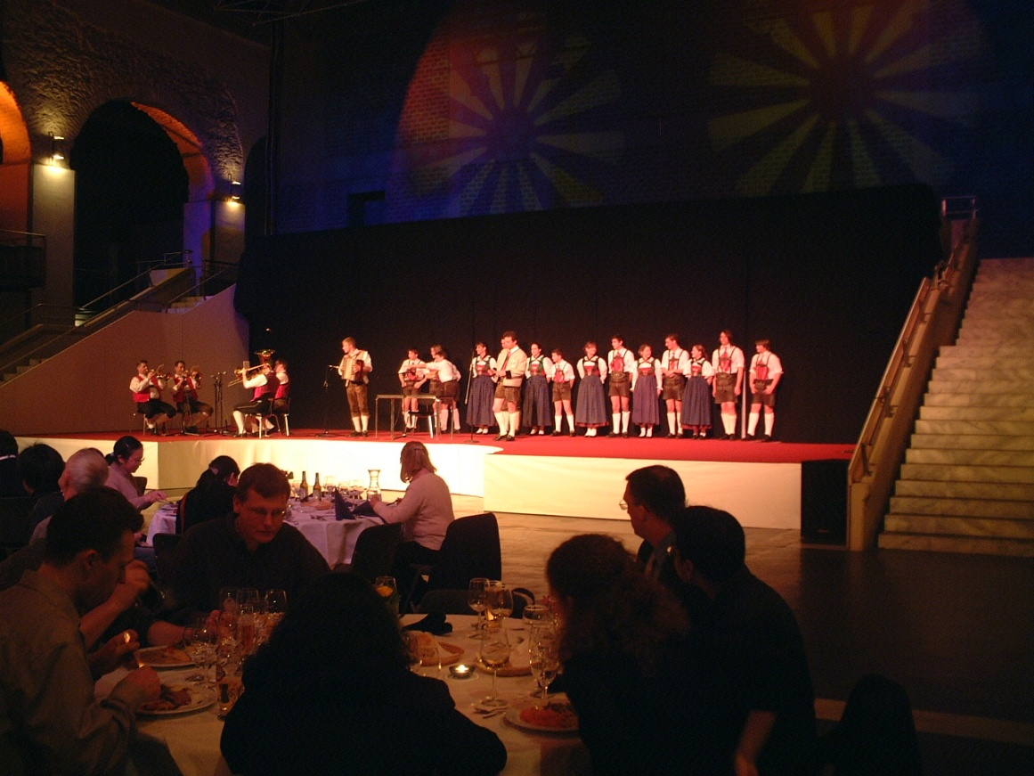
International Conf.
国際会議
Ethnic dance and music
Banquets
Ethnic dance
Banquets, IASTED, Innsbruck, Austria

Slide 41
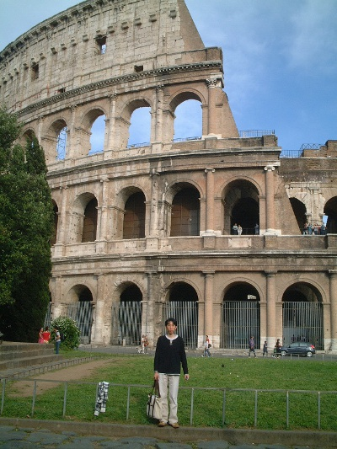
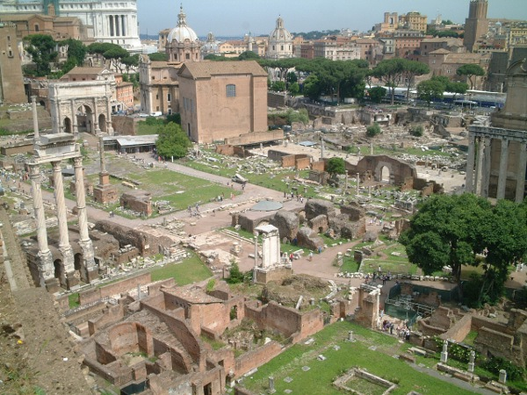
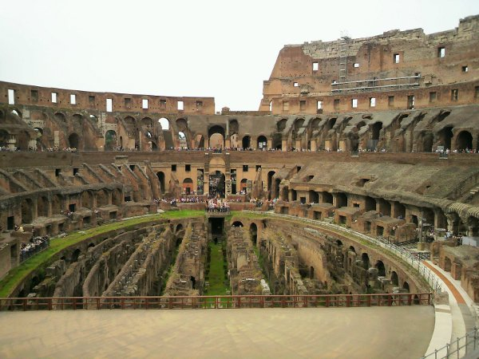
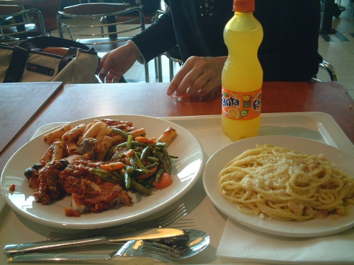
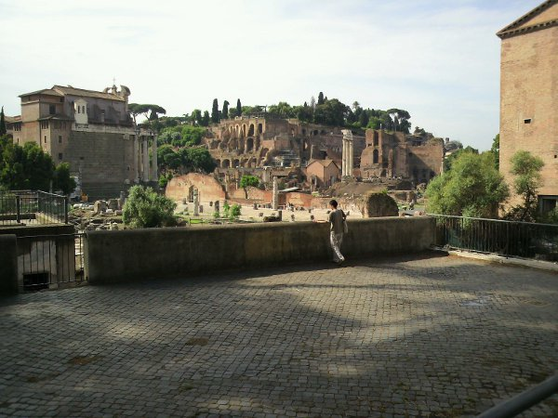
International Conf.
国際会議
The Colloseum
Palatine Hill

Slide 42
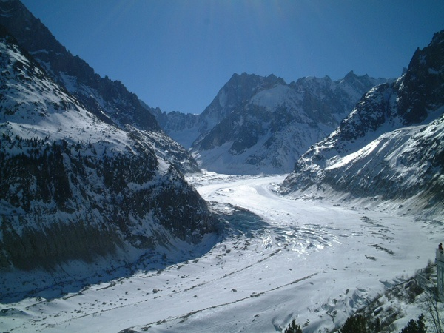
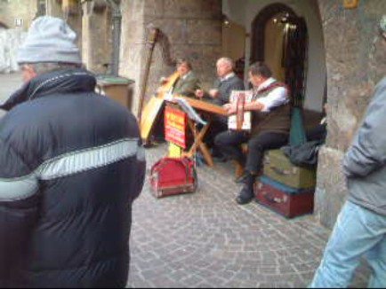
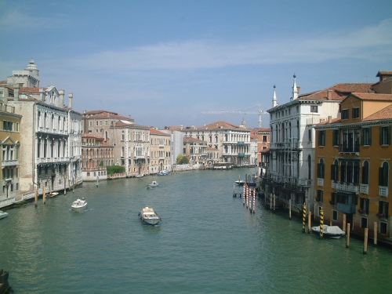
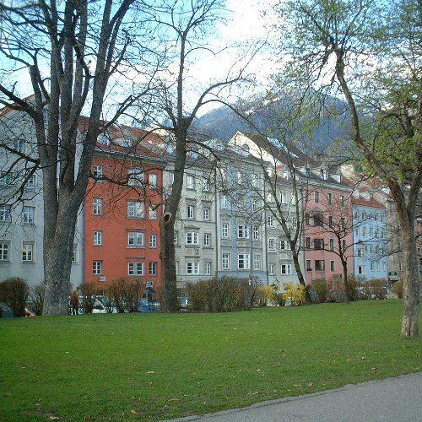
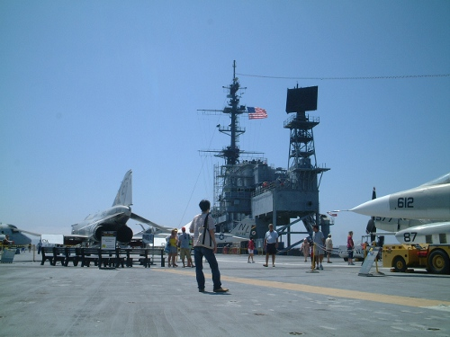
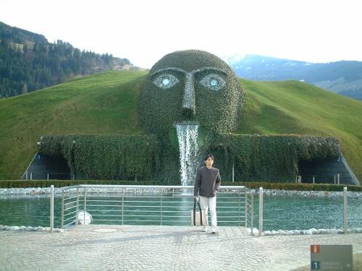
International Conf.
国際会議
Glacier
Venetia
Innsbruck town
Swarovski Crystal
Aircraft carrier
MIDWAY

Slide 43




Mixed Reality
混合現実感
Buildings
Mixed reality
Physical reality
Augmented reality
Augmented virtuality
Virtual reality
Quake I
Photos from ARQuake project, Wearable Computer Lab, University of South Australia

Slide 44




Mixed Reality
混合現実
AR Toolkit
・Software library to build an AR environment.
・Freeware
・C, OpenGL
overlay
G
Demo

